Slide 1
Java Workshop 4 – Arrays & Lists
Java has a large list of arrays and collections
Ben Schwarz

Slide 2
Lesson Outline
Learn Arrays
Learn Iterating over Arrays
Learn Array Lists

Slide 3
Arrays
Arrays
Imagine I have a hotel with ten rooms inside it and want to track the number of guests that are residing within each individual room
Many of you will think to declare ten different variables to track the number of guests in each room
But now that we look at it much more closely, we can see that this seems rather inefficient, both in its declaration, and by the fact that you have to reference each variable on a separate line to interact with them
This way might now seem very clunky to you now. Surely a better way exists, right?
int guestsInRoomNum0, guestsInRoomNum1, guestsInRoomNum2, guestsInRoomNum3, guestsInRoomNum4, guestsInRoomNum5, guestsInRoomNum6 . .
Analogy inspired by “Java for Dummies 6th Edition”

Slide 4
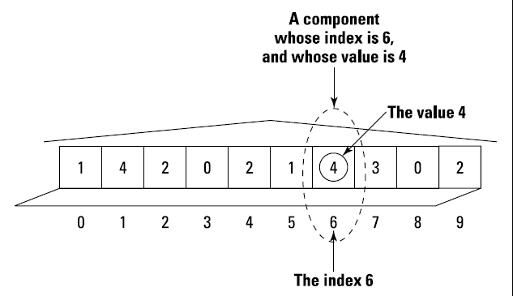
Lesson 12: Other Java Concepts
This better way is known as an array, which some of you may know from your time programming in python to be lists
An array is a row of values, like each room in order in our motel.
The entire row of rooms you can see to the right is called an array
Each room in the array is called a component of the array, and each component has an element associated with it (In this case, the number of residents in each room)
The Java Motel
int guests[] = new int[10];
guests[6] = 4
Analogy inspired by “Java for Dummies 6th Edition”

Slide 5
Arrays vs Lists
If we define a list to be a sequence of information, arrays can be seen as a special type of list. An array has
A fixed order of items
A fixed datatype for all of its items
A fixed length, defined at initialisation, with the first item having an index of 0
Note that if you’re familiar with python, it doesn’t have arrays. It has lists, which don’t have the restrictions mentioned.

Slide 6
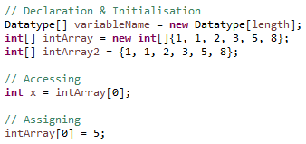
Syntax Overview – Arrays
Declaration & Initialisation:
The first line leaves each value un-initialised
The second line populates an array with the given data
The third does the same as the second, but only works in the same line as the declaration
Accessing:
In this case, x is set to the first array value
Assigning:
This is the same syntax as accessing

Slide 7
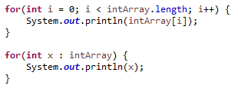
Iteration over Arrays
There are two ways to iterate through an array:
Getting the value at each index between 0 and the end of the array
Setting a variable to have the value of each element of the array, using a special for loop
Both of the loops given print all values from the array on the last slide.

Slide 8
Exercises
Assign an array to hold the integers from 1 to 10, and then print the values of the array to check your result
Assign an array manually to hold the values 3, 1, 4, 1, 5, 9, 2, 6, 5, 3, then print all of the odd values
Populate an array with the values of the Fibonacci sequence up to the 20th value
Group Discussion – how would we create an array of prime numbers?

Slide 9


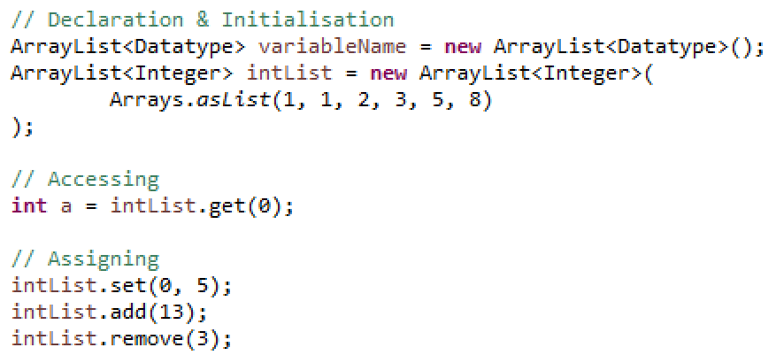

Syntax Overview - ArrayLists
Declaration & Initialisation:
The first line is an empty list
The second line populates a list with the given data
Accessing:
In this case, a is set to the first array value
Assigning:
Set changes an existing value
Add appends a value to the end of the list
Remove removes the value at a given index

Slide 10

Exercises
1) Generate a list of numbers in the Fibonacci sequence less than 1000
2) Create a list of the prime numbers up to 100
3) Allow a user to input a list of presents for their Christmas list to send to Santa – one at a time. Once they have finished print out a sentence saying “Your Christmas list is a, b, c… and d.”

Slide 11
Summary
You should now be able to:
Identify the properties of an array that distinguish it from a regular list
Create and modify arrays of information
Iterate through an array using either indices or the notation for each element in …
Use ArrayLists as variable-length arrays

